Slide 1
Security Training 2026

Slide 2
Introduction and Agenda
Purpose of Security Training
Roles and Responsibilities
Security Training and Awareness
Data Privacy and Classification

Slide 3
Before we Begin
Yes, we do have a compliance-based obligation to do security training
But cybersecurity awareness is an important life skill
  How many people here know someone who had an account login stolen, were a victim of identity theft, or were the victim of a scam?
Everything in this security training is applicable outside of our work.
  The same tactics being used to spearphish CEOs are also used to confuse our parents and our kids.
  The same 2FA methodology used to protect a businesses’ intellectual property also prevents you from identity theft.

Slide 4
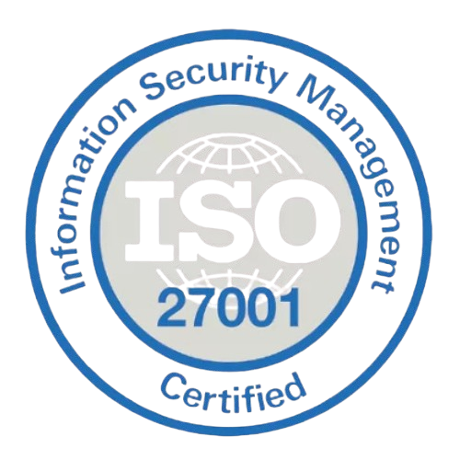
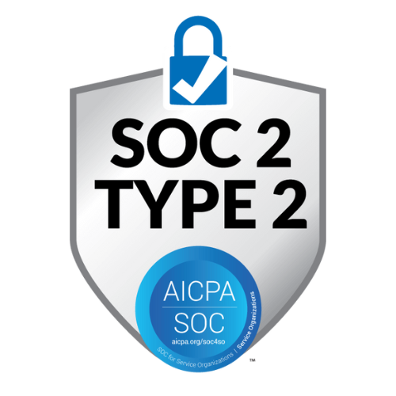

Compliance Requirements
ISO 27001
International standard for Information Security Management Systems (ISMS). Requires systematic management of sensitive information through defined policies and controls.
SOC 2
Service Organization Control 2. Audits our security controls across five trust principles: Security, Availability, Processing Integrity, Confidentiality, and Privacy.
HIPAA
The Health Insurance Portability and Accountability Act is a U.S. Federal law regulating the protection of sensitive information in Healthcare-related contexts.
Notes:
Why it matters
These certifications demonstrate our commitment to protecting customer and company data, and are required by many of our enterprise clients. Your participation in this training supports our compliance obligations.

Slide 5
Roles and Responsibilities
IT Team
Security Team
Decides on and implements security policy and standards across the organization
Continually monitors and improves organizational cybersecurity posture
Handles security concerns, questions, and response to security incidents
All Employees
Handles the implementation of Security Policy
Implements and updates security practices in infrastructure
Advises and mitigates reported threats
Adhere to device usage guidelines in-office, remotely, and in public
Practice thoughtful data handling, especially with sensitive information
Report incidents, breaches, or suspicious activity
Attend annual security training

Slide 6
Security Fundamentals
Important Concepts
Social Engineering
A Mindset of Verification
Passwords and authentication
Multi Factor Authentication
Best Practices
Secured Networks
Your Digital Footprint
The Impact of AI
Data Privacy

Slide 7
We Won the Cybersecurity Arms Race
The good news is modern encryption algorithms, firewalls and antivirus have made brute force hacking methods mostly irrelevant.
For the last few decades, we have become extremely good at conventional cybersecurity defense.
  MFA broadly implemented
  Well-adopted encryption standards
  Ubiquitous antivirus coverage
  Rapid security patching cycles
So we have an impenetrable fortress. Cool.
But what happens if you’re just really really nice to the gatekeeper? Maybe they’ll just… let you in?
Notes:
We built moats wider and deeper to the point that it became impractical to try to attack directly.
Most attack vectors can have security scaled linearly: harder encryption takes longer to hack.
The rise of MFA essentially eliminated the possibility of any sort of brute-force login attack. Patching cycles became more frequent, encryption became practically unbreakable. Antivirus management tools became intelligent and comprehensive.

Slide 8
We’re Still Under Attack
Social Engineering emerged to fill the space previously occupied by attacks on software and hardware.
Social Engineering remains the primary and most significant way that security is exploited in 2026. 98% of all successful cyberattacks involve the usage of social engineering.
A social engineering attack manipulates people instead of technology by exploiting trust, authority, urgency, and fear to extract information or trigger harmful actions.
Notes:
That’s not just a trend, that’s almost complete saturation.
I originally designed this slide with graphs and statistics beyond this one, but honestly this is the only one that matters.
Frankly, cybersecurity statistics show such a massive trend in increases that it’s not even really helpful to state them as scare tactics here because of the sheer volume.

Slide 9
Social Engineering Attack Types
Common attack types
Phishing (email), Vishing (voice), Smishing (SMS), Pretexting (fabricated scenarios), Baiting (infected drives or downloads)
Why it works
Attackers exploit our natural tendency to be helpful, to comply with authority, and to respond quickly under pressure.
Unlike firewalls and network rules, social engineering considers that a person may be distracted, tired, agitated, or concerned, meaning that even that same method may eventually allow for security to be compromised without changing the mechanism.
Notes:
Awareness is the most effective defense.
So many vectors that it’s not really helpful to provide an exhaustive list
This is *always* the common thread. Which is why questioning the reason for a request and validation authenticity are the only practical tools we have.

Slide 10
Why “Spot the Fake” is Failing
Phishing messages (email, SMS, Teams, WhatsApp etc.) are the most popular method for social-engineering based security attacks.
In previous years, we’ve been able to use data points which are still valid:
  Check sender’s address
  Hover over links to check before clicking
  Look for grammatical errors
We can still use these to find obvious errors. But seriously... when was the last time you received a message like that?
Placing a bias on looking for obvious tells can lead to overconfidence in assessing if a social engineering attack is occurring.

Slide 11
From “Spot the Fake” to “Validate the Request”
Today’s social engineering attacks have become a lot more sophisticated, and laser-focusing on spotting a fake can actually have the effect of preventing us from noticing more subtle tells.
AI Generated emails enable the generation of grammatically flawless, relatively natural sounding emails
Publicly available context can be used to personalize an attack with specific details
Systems can respond to input dynamically (chat or email reply)
Old thinking | New thinking
“Does this email look authentic?” | “Does this request make sense?”
“Do I recognize the name of the sender?” | “Would this person ask me this?”
“Did this get flagged as spam/junk?” | “How can I verify that this information is true?”
“Is this site using HTTPS / Is the certificate current?” | “Does performing this action give someone access to something I have?”
Notes:
We talked about AI Vishing and voice cloning last year
There is no point in trying to “keep up” with the tells, since the technology to fake things is improving.
There IS no comprehensive list of all current things to look out for
But the core logical facts remain – an IT support person doesn’t need your password.
You don’t need to open an attachment from an unverified contact.
No matter how good the fabrications become, the underlying scam always remains the same: someone is trying to gain access that you have

Slide 12
The Verification Mindset: Practical Tools
Verify through a different channel.
A request for action such as credentials, access, or sensitive data should be confirmed via a channel you initiate, using contact info you already trust.
1
Treat urgency as a red flag.
Real emergencies can survive a five-minute verification call.
2
Ask: would this person do this, this way?
Trust your instincts about context. If something feels off, that feeling is data.
3
Report what you see.
Even if you didn’t fall for it, even if nothing happened. Verification protects you individually, reporting protects everyone.
4
Notes:
No info on hand? Check official website, etc. Don’t use details provided in a message
Make an excuse (headset broken, battery) and call them back on a known good number
Buy time - Make an excuse (headset broken, battery) and call them back on a known good number most scam scripts or presentations can’t survive a change of context
3. "You already know what it feels like when someone you talk to regularly sounds a little off. Maybe they seem distracted, or rushed, or just not quite like themselves. You notice it without thinking about it.
That noticing is data. And now that voice cloning exists, it's security data.
I'm not asking you to do anything differently — just to recognize that if a call feels wrong, even if you can't say why, that feeling is worth pausing for."
Cheers, big ears
Your word is as valuable to me as a Bronzed Ham
Family “safe words” etc
4.

Slide 13
What Does Social Engineering Look Like?
Imagine we wanted to infiltrate Prowess Consulting by using a PDF attachment with a malicious payload.
This sounds like a complex to execute attack, but in reality, all we need are a few pieces of key information to construct a believable-enough story to catch one person off-guard one time.
Notes:
When the PDF is opened, would make a local firewall exception that allowed for remote access when a computer was online and connected to the internet.

Slide 14
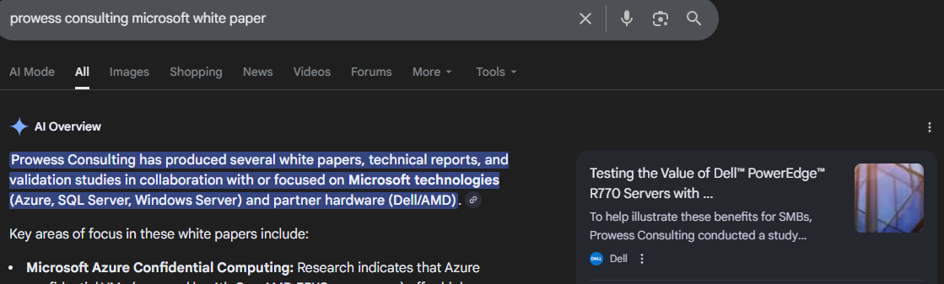
What Does Social Engineering Look Like?
Notes:
When the PDF is opened, would make a local firewall exception that allowed for remote access when a computer was online and connected to the internet.
Now we know Prowess did a white paper for Dell (specifically on R770 Servers).
From the Prowess website we know they’re based in Washington.
Even if this didn’t exactly match my search for “Microsoft”, doesn’t matter. We’re just gathering context.

Slide 15
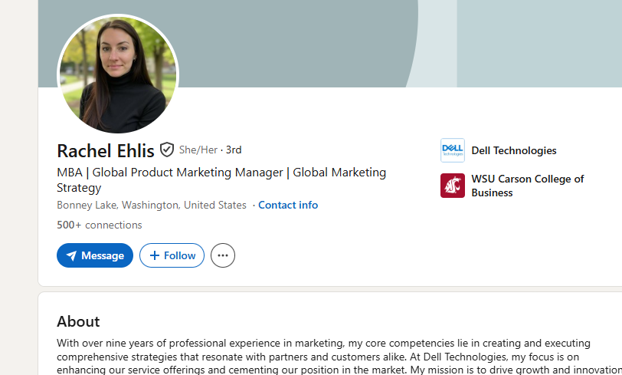
OSINT (Open-Source Intelligence)
Another quick Google search and we learn the name of a Global Product Marketing Manager working for Dell in Washington.
We may have never worked with Rachel before.
Even if we have no relationship or connection to Rachel, we’re only doing this to build credible, plausible background intelligence to execute our attack.
Notes:
Remember: Social Engineering preys on human nature, we inherently want to believe someone is being truthful and transparent with us.

Slide 16
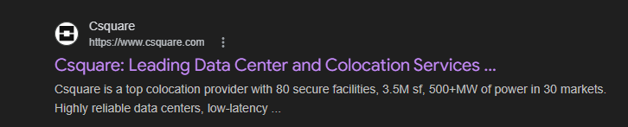
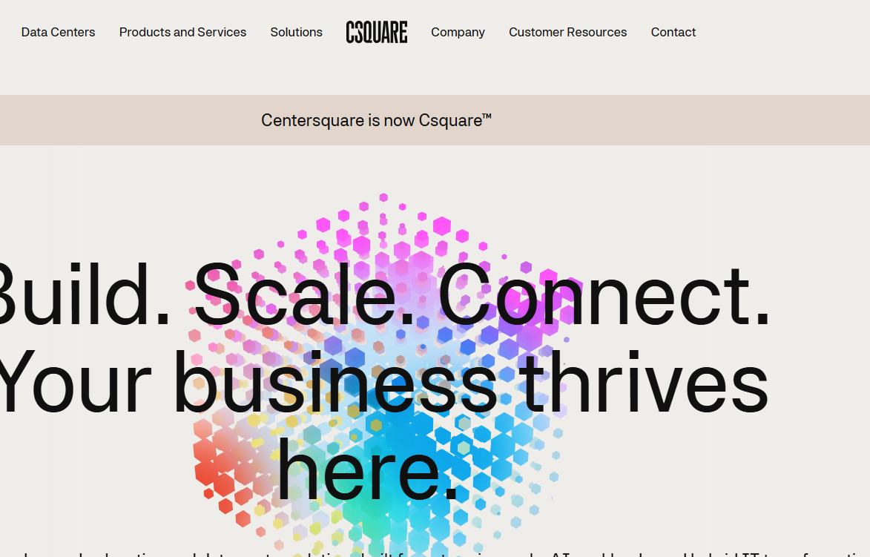
Pretexting
And yet another search tells us that Csquare is a datacenter / server colocation provider based out of Dallas with large and growing presence including Seattle. The website states “Formerly known as Centersquare”.

Slide 17
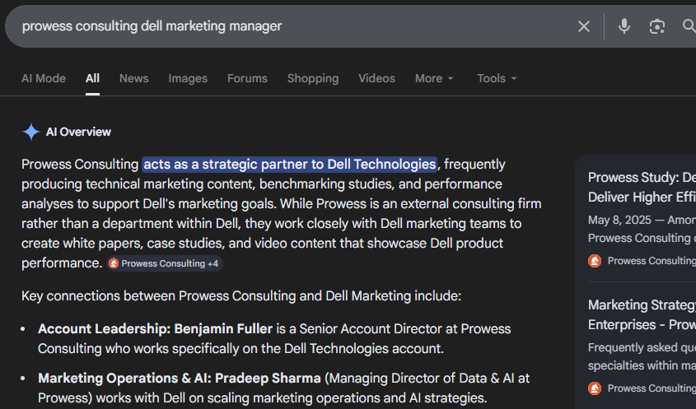
Making Connections
One last Google search helps us find our very own Pradeep Sharma.
Several contact details for Pradeep are on his LinkedIn page, but even without an email address we can see on the Prowess Website that info@prowessconsulting.com is offered as a contact address.
From here, we can just guess that Pradeep.Sharma@prowessconsulting.com is a likely contact point.

Slide 18

Putting it Together: Spear-Phishing Example
Partnership inquiry: PowerEdge AI infrastructure piece
Hi Pradeep,
Rachel Ehlis suggested I get in touch, and mentioned Prowess would be a great fit for something we're putting together. We're Csquare (you might know us as Centersquare, we rebranded earlier this year). We operate data centers in the Seattle region and we're working with Dell on a joint content piece about PowerEdge deployments for AI workloads. I came across your R770 white paper and thought your team's perspective would be a great addition. We're looking for partners who've done real implementation work rather than just vendor talking points. I've attached a brief overview of the project and what involvement would look like. Would love to find 15 minutes to chat if this sounds relevant.
Best,
Marcus Chen
Partner Development, Csquare
Datacenters for AI with Dell Outline.pdf
Notes:
That took me four Google searches and about four minutes.
There's no typo to catch. The company is real. The rebrand is real. Rachel is real. The white paper is real. Pradeep is (probably) real.
If you're the person who receives this, what's your red flag? There isn't one — unless you're asking different questions: "Did Rachel mention this to me? Let me ping her on Slack before I open this.“
The point here is, this may not be a perfect narrative, and it may not fool someone every time, but it’s very simple to construct something like this.
Pretexting / OSINT / Spear-phishing

Slide 19
What Should We Actually Do?
So what’s the best course of action here? This email is potentially harmless and legitimate, but perhaps also unexpected and surprising in some way.
What’s the best course of action?
Don’t open the attachment.
  Reading the email is harmless. The email isn’t the threat. Social Engineering requires us to perform some kind of action that compromises security or provides access. It’s the action you may potentially take that causes the breach.
  Send a message to the IT Team if you feel any suspicion. They have tools to check attachments safely.
Ask “does this make sense?”
  Do you have a contact at Csquare or is this totally cold? Do you know Rachel? Is there someone at Prowess connections to Dell who may know Rachel to validate this story? Do we normally get requests like this, and would they come to you personally?
Initiate verification with a trusted alternative channel.
  Is “Marcus Chen” really a person? Without using contact details from the email, look up Csquare and call their Seattle office. Ask to be connected to Marcus Chen. If the ask is legitimate, they won’t mind anyway.
Notes:
So you've received this email. It looks legitimate. It references real people, real work, a real company. There's a PDF attached.
Here's how verification mindset applies

Slide 20
Your Digital Footprint
Assume everything available publicly about you is information that everyone can know
Remove unnecessary online details if you aren’t comfortable with everyone knowing them
What attackers harvest
LinkedIn profiles, social media, conference bios, company websites, and public records all provide material for crafting personalized attacks
Think before you share
Be selective about publishing: job titles, project names, org structure, travel plans, and personal contact details
Periodically Google yourself
Know what information is publicly visible about you and take steps to remove or limit what you’re not comfortable with

Slide 21
Helpdesk and Incident Reporting is Crucial
As conventional attack methods become more difficult to compromise, helpdesk and IT teams are increasingly targeted by social engineering themselves
Therefore, it’s important to follow IT protocols and procedures so that a culture of trust and verification can be established
If you suspect a data breach has occurred, report it! We’re not going to punish honest mistakes, and compromises can be corrected best when reported as early as possible
Use official channels for reporting incidents (Teams, Freshservice, IT Support email address)
Notes:
Having a culture of trust is a core part of good internal security
Attackers are also betting on people being too embarrassed to report potential threats as part of the mechanism of social engineering

Slide 22
Passwords: Why the Old Rules Failed
“Much of what I did I now regret” – Bill Burr, author of the 2003 NIST password guidelines
Expectation | Reality
Complex passwords are secure | To remember complex passwords, people use predictable patterns
Frequent password rotation ensures safety | To keep up with rotation, people make simplistic, predictable changes to passwords
Special characters make passwords hard to crack | Hacking algorithms can specifically target common predictable character substitutions
Do you see the common thread? People break down complexity in predictable ways.
These standards ended up having the opposite effect. We were left with a system that was hard for people to use, but easy for computers to break.
Notes:
In 2003, a mid-level manager at the National Institute of Standards and Technology wrote an eight-page document that shaped password policy for two decades. Bill Burr's guidelines became the standard for government, banks, and corporations everywhere.
You've felt his influence: change your password every 90 days, use uppercase, lowercase, numbers, and special characters.
Years of research has shown that these measures actually don't do that much to foil hackers. Burr, now retired, admitted to the Wall Street Journal: "Much of what I did I now regret." So what went wrong?
Talk about how when the rules were being written up we didn’t have all the data we have today about how passwords can fail.

Slide 23
Password Complexity
Password | Structure of password
F^mJ&[@1 | 8 mixed, randomized characters
tus^Ua})}]NsDU'Zo6lcmeq,Ifv56P)xD'TpNfRX#iS,Hoh | 47 mixed, randomized characters
this is my cool way of logging in to the system | 47 lowercase letter phrase with spaces
It’s obvious that one of these passwords is easier to memorize!
But how different are they in terms of security?

Slide 24
TLDR; Long Passwords are Strong Passwords
Password | Time to be cracked using modern methods
F^mJ&[@1 | Less than one 1s
this is my cool way of logging in to the system | 1,650,000,000,000,000,000,000,000 years
tus^Ua})}]NsDU'Zo6lcmeq,Ifv56P)xD'TpNfRX#iS,Hoh | 317,000,000,000,000,000,000,000,000,000 years
You may have already heard of how passphrases tend to be more secure than passwords.
But the effect of length on password strength may be more than you had expected!
Notes:
about 2.75 million times longer than the universe has existed.

Slide 25
Tips for Making Long Passwords
Don’t use personal facts that could researched or guessed (previous addresses, phone numbers, full names, etc). If it’s on your Facebook page, everyone can know it.
Try to think of something that has personal meaning to you but isn’t easily guessed:
“I never eat the red skittles anyway” (682,000,000 years)
“a true gentleman prefers the double windsor” (309,000,000,000,000 years)
“avocado toast isn’t even that popular!” (46,000,000,000,000,000 years)

Slide 26


The Best Password Is One You Don’t Know
Moreover, you should really have an individual password for every single site or service that you use.
Remembering one password isn’t so bad, but remembering one for every site you use is a major pain.
Using a password manager (even a free one built into your browser or phone) is an excellent way of ensuring that you generate secure, unique passwords for each account.
Each unique secure password you use improves your overall security posture.
Notes:
The reason you should have unique passwords for everything is simple: if one of your passwords is compromised (even through no fault of your own!), what other accounts could that potentially give access to?
This is difficult advice to use if we concede that passwords are bad and hard to use.

Slide 27
The End of Passwords? MFA / 2FA
We’re increasingly moving towards “multi-factor passwordless” solutions as the new standard.
But before we dive into that, let’s quickly identify what “multi-factor” really means.
Three Categories of Authentication
Something you KNOW
Something you HAVE
Something you ARE
Password
Phone (SMS etc.)
Fingerprint
PIN
Hardware key
Face ID
Combination Lock
Bank Card
Voice recognition
Security Question
Physical Key
Retina scan
Alarm Code
Bus ticket / pass
In-person recognition
Notes:
All of this is probably making you realize that passwords themselves are a fundamentally flawed solution. We had to even invent a new class of software to make them usable in a secure way by humans.
The fundamental function of passwords is identity verification. Does the individual attempting this access attempt have authorization to do so?
But when passwords were conceived, we weren’t all carrying a fingerprint sensing lidar face scanning supercomputer in our pockets which is conveniently accessible at all times.
However nowadays, we have a smartphone on our person which can perform those functions to validate our identity in a much more convenient and secure fashion.
Concert wristband = HAVE (1 factor)
Password only = KNOW (1 factor)
Password and security question = KNOW and KNOW (1 factor)
Password + SMS = KNOW + HAVE (2 factor)
Debit card + Pin = HAVE + KNOW (2 Factor)
Bad 2FA Examples:
Passport + face check = HAVE + ARE (2 Factor)
Credit card + signature = Have + ARE (2 Factor)

Slide 28
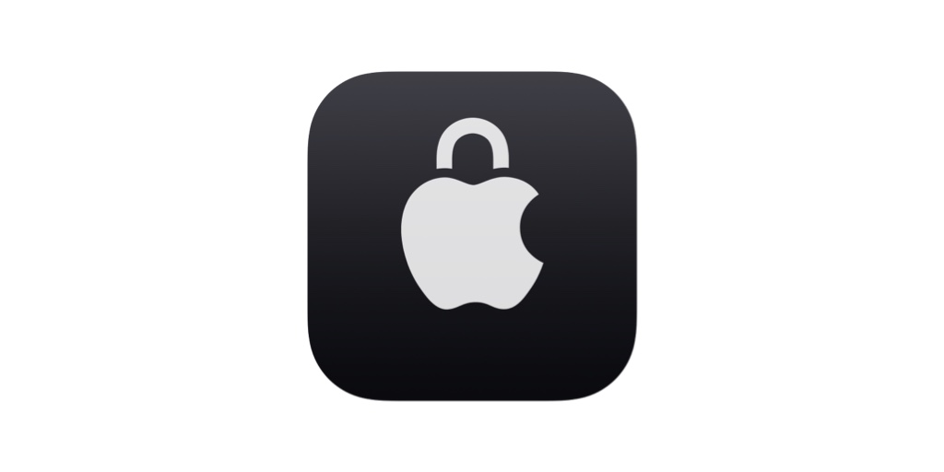
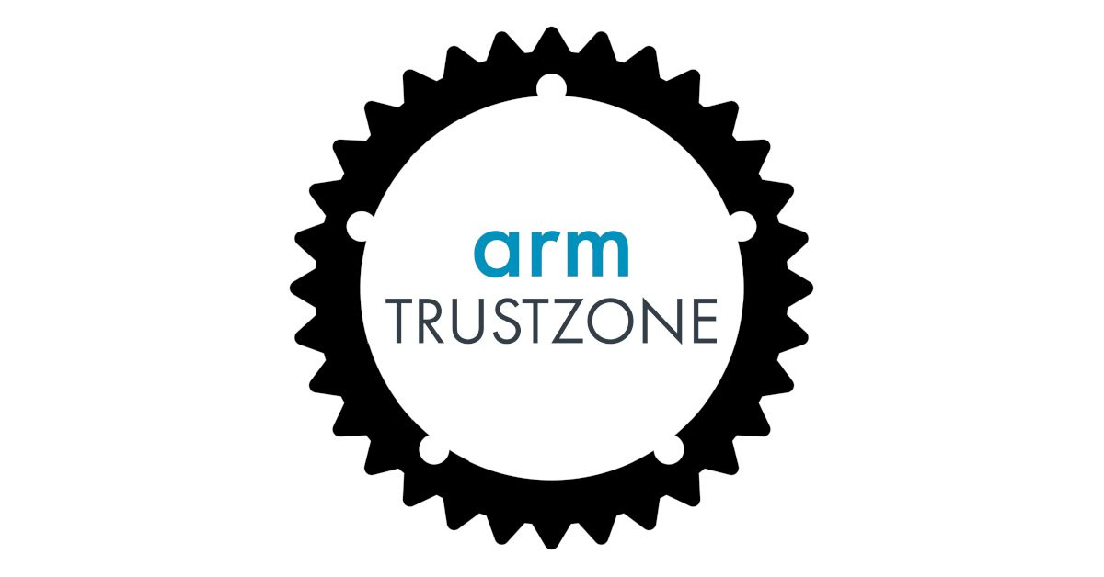
Passkey Authentication
Passkeys utilize special security hardware on modern smartphones to store a unique access credential that is tied to a specific device and a specific individual. They can only be accessed when both are present simultaneously.
Explanations often involve understanding asymmetric public-key cryptography, relying party trusts, challenge-response and other jargon. Cool nerd-words but not really easy to understand.
So to try to illustrate how “passkeys” work, we’ll go with a simple analogy using keys.
Apple Secure Enclave
ARM TrustZone
Notes:
“Passkey” is a new term you may have heard, and Prowess implemented for all accounts this year. Despite the name seeming straightforward, a lot of people don’t understand how it’s different from normal sign-ins.

Slide 29
Passwords are Silly
Imagine each time I buy something at a new store, I give them a copy of my actual real house key, because I love unnecessary risk.
“Hold on to this key, shopkeeper! And if you ever need me to prove it’s really me, we can compare your copy with my copy.”
The shopkeeper keeps a copy of the key in a drawer, and attaches a little note with “Julian” written on it.
I repeat this procedure for every store I ever visit. It’s sort of insane but it does function as an identity validation system.
One day, someone robs the local Home Depot and gets a copy of my key, and can then use it to prove they are me at Home Depot, but also at any of the other shops I’ve given a copy of my house key. Maybe even my bank. Also, it can be used to open my house.
If you use a password-only login system, and re-use your passwords, this is essentially how they function.
Notes:
When you sign up for a website, you hand them a copy of your house key and say “hold on to this and please don’t lose it”.

Slide 30
Passkeys are Good
A passkey works differently.
Instead of giving the shopkeeper a copy of my valuable house key, I give them a one-of-a-kind padlock, which can only be opened with a trusty one-of-a-kind key that I only use for that shop. In fact, the key so trusty that it refuses to work unless it’s being held by me specifically. It’s deeply loyal.
When the shopkeeper says “Hey, are you really Julian?” I pull out the special, loyal key for Home Depot and put it in the special Home-Depot specific padlock that I gave them and the lock pops open. We’re sure it’s me, and my identity has been verified.
Later on, the same Home Depot gets robbed (again!) and they steal all the padlocks.
But the padlocks themselves are useless without the one-of-a-kind keys.
And even if they had my key, it only works when I’m the one holding it, so there’s no possibility of it being used nefariously.
Even if someone sets up a whole fake Home Depot and I believe it, since they don’t have the one-of-a-kind padlock, my key won’t work there anyway.
Notes:
Fake home depot doesn’t have the padlock so it wouldn’t work with the key

Slide 31
Passkey Terminology
Home Depot padlock = the public key for the Home Depot website
Trusty Home-Depot specific key = the private key stored for the Home Depot website on your phone or password manager
The padlock + key combo = a “key pair” or “passkey”
The shopkeeper = the “relying party” asking you to prove your identity
The trusty key that “only works for me” = biometric authentication (for example, phone fingerprint or face scan)
It’s worth noting too that passkeys are multi-factor by design. The private key on your phone is one factor, and the biometric access to unlock the phone is a second factor. 2FA without the involvement of passwords.

Slide 32
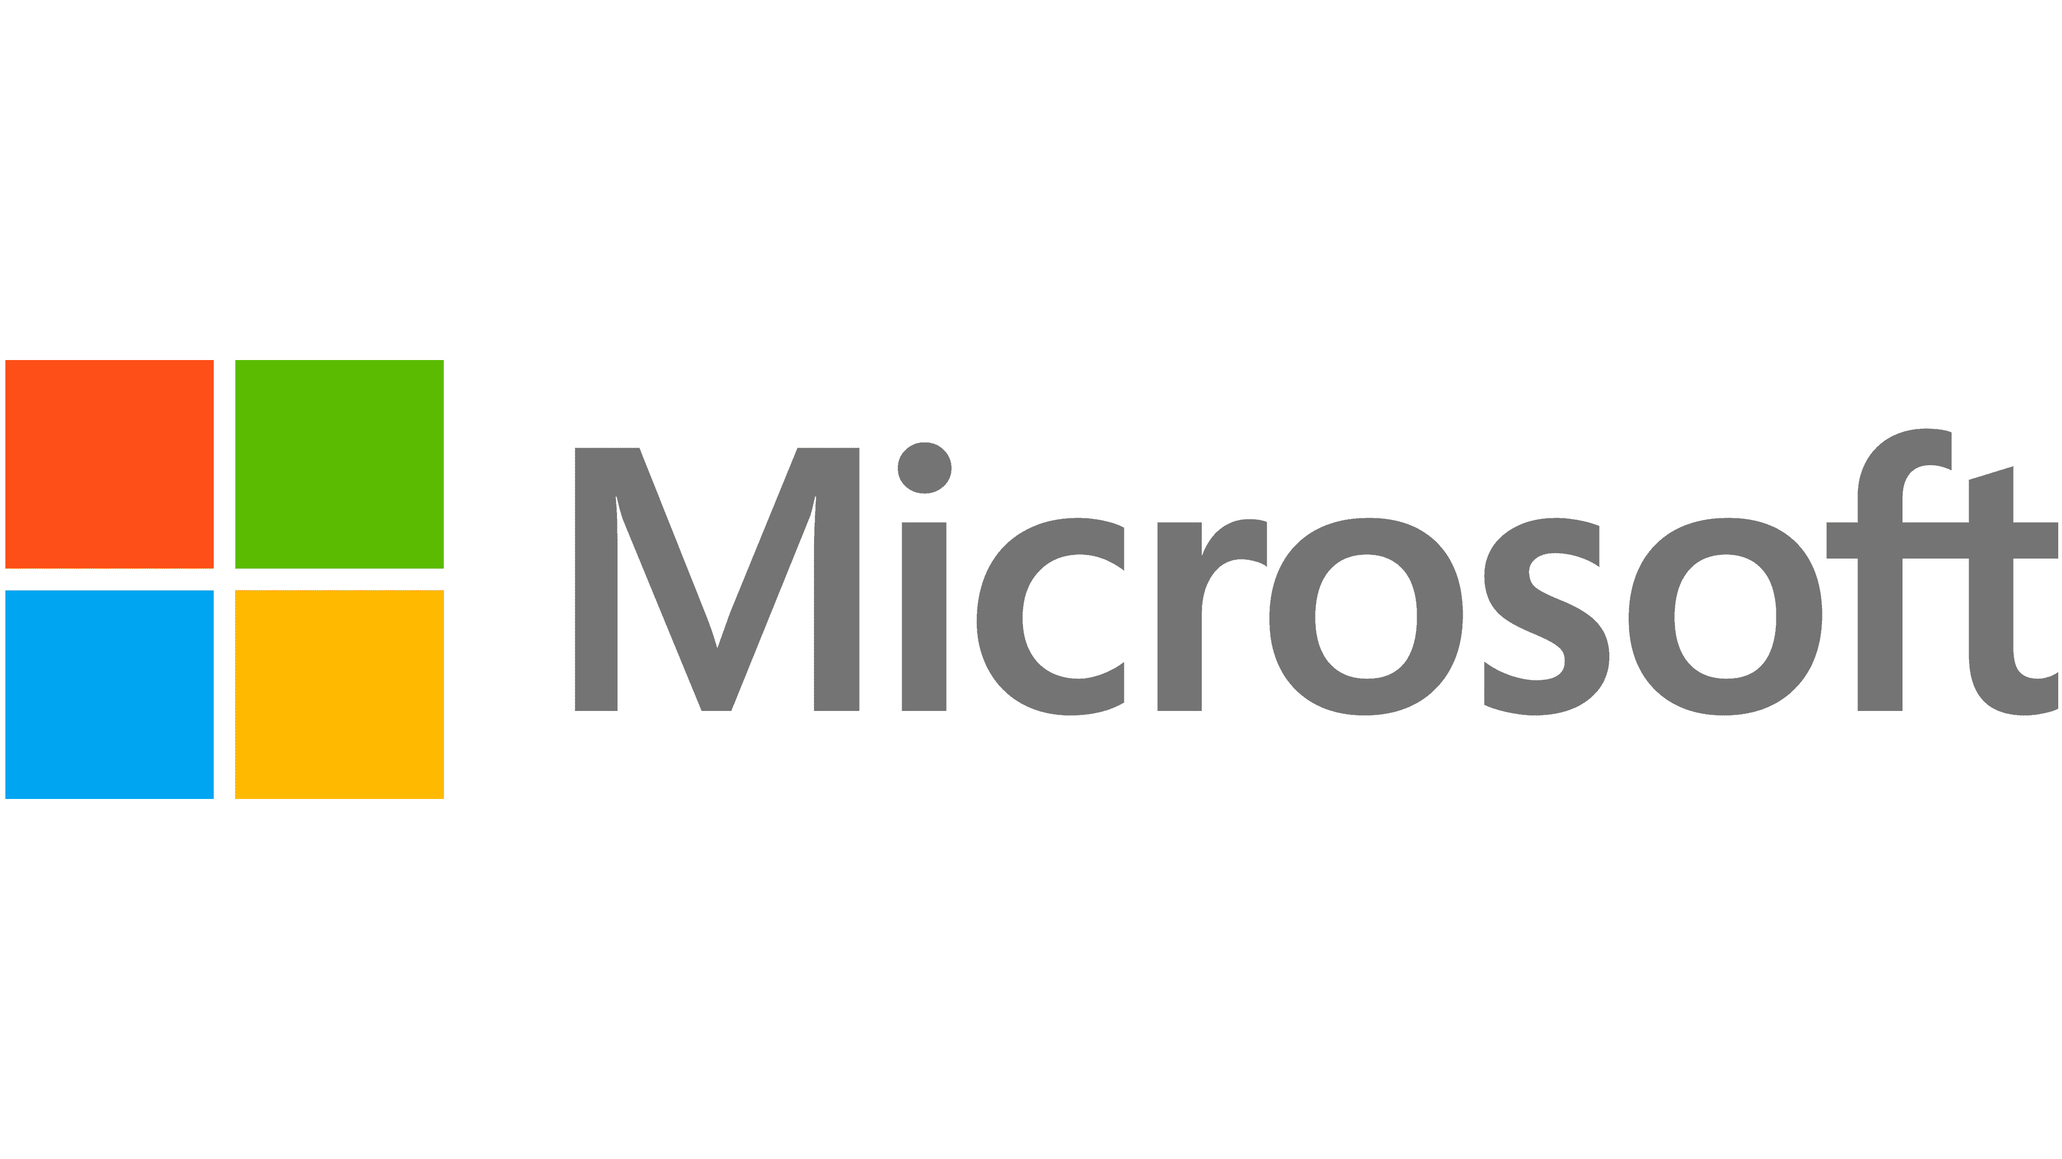



Passkeys are available now
Notes:
Passkeys are being adopted but often as an opt-in solution.
Since they’re so good, consider switching to a passkey model if you use accounts (even connected accounts) via providers offering passkeys.

Slide 33
Authentication Factors are a Spectrum
Sometimes, the services and websites we use aren’t architected to use modern technologies like passkeys.
The most common implementation like this is sites that use email for a “one-time-password”.
Even though Email “one-time-passwords” are not true 2FA and are often considered weak (KNOW password + KNOW one-time-password), we can receive the one-time-password on a passkey-secured email account (HAVE phone + ARE you) and improve the overall security of the login.
This is a security principle called “security inheritance” or “chain strength”.
Security is a spectrum, and you almost always have more leverage than you think.
Notes:
You may wonder too, how all of this relates to places where passkeys are not available.
The fact of the matter is, you often still have a lot of control over how you implement security.

Slide 34
Secured Networks
Do | Don’t
Use a VPN when working on public networks | Ignore certificate warnings on networks or websites
Use your phone’s cellular network connection instead of WiFi in public places | Don’t assume that a “correctly named” network is authentic
Just because a network requires a password to join doesn’t inherently mean it is safe, only that not everyone can connect to it.
Consider circumstances like conferences or hotel rooms where credentials can be obtained with moderate ease by bad actors.

Slide 35
Physical Security Basics
Tailgating: Following someone into a secured area as they are opening a door, or merging into a group of people who have access
Clean desk: Ensuring that your physical desktop is clear of materials that could provide access or secured information. This is especially important if you work with sensitive information like personnel files, or on projects with private information.
Locking screen: Ensuring your desktop is locked when you’re not at the keyboard.

Slide 36
Data Classifications
Restricted - The highest, classification of security for data we store in the organization.
All data containing PHI is considered Restricted.
Any data that could potentially cause serious or potentially irrecoverable damage to Prowess or the customer if breached or leaked.
Examples of Restricted data include:
Confidential - The default level of classification for all data entering Prowess, meaning almost all data we encounter is Confidential.
Confidential data should only be shared with people who require the information to do their job.
Examples of Confidential data include:
Internal - Information intended to be available to all Prowess Employees.
Internal information is information that functionally requires it to be made available to all employees to be useful.
Examples of Internal information include:
Public – Information not requiring any specialized access control.
Poses no risk to Prowess if distributed or encountered internally or by a third party, as well as information intended to be distributed publicly.
Examples of Public data include:
Prowess intellectual property (project-related data),
Prowess systems architecture diagrams,
Financial information,
Business performance information,
Business-related email or chat communications
Internal email and IM-based communications regarding business operations,
Internal meetings and recordings,
Organization charts,
Internal procedures or policies such as SOP documents and company calendars
Published works for intended for general audiences
Website and Marketing materials
PHI and PII
Passwords or access codes,
Some employee information including background checks,
Strategic plans or data about unannounced business plans or products, mergers, acquisitions, or otherwise highly sensitive business information

Slide 37
Data Security: One Call to Action
Instead of going into detail about what each of these classifications mean technically and which ones map to which controls for each certification, I want everyone to take away just one thing:
If you notice you or someone else has access to something they don’t need to perform their job, notify IT.
More often than not, access control list issues are potential audit issues waiting to be surfaced. This is the simplest way for us to maintain broader visibility beyond the auditing and monitoring we already do.

Slide 38
Recap: Practical Strategy for Cybersecurity Safety
Verification Mindset
  Move from “spot the fake” to “verify the request”
Criticality of the IT team
  IT Team follows procedure
  We all support them by adhering to standardized practices
Access Control
  Long passwords
  Password Managers
  Passkeys
Incident reporting
Awareness of “digital footprint” and data storage

Slide 39
Questions & Discussion
If anyone has any questions about today’s training (and if we have time!) I’d love to take questions!
Report security incidents via:
Teams
Freshservice
IT Support email address
Send security or compliance questions to me directly:
julian.lancaster@prowessconsulting.com

